Slide 1
Autonomous Sailboat
ECE 445 Project Pitch Spring 2024
Arne Fliflet
afliflet@Illinois.edu

Slide 2
Autonomous or robotic sailboats have been developed for a range of applications including ocean-going weather sensors
Autonomous sailing represents a challenging control problem
Given a destination and wind direction, a course must be determined
Sails must be trimmed according to course, wind, and boat heading directions, and wind strength
The boat rudder and sail trim controls must be continuously adjusted to maintain desired course and optimum boat speed
Complex maneuvers such as tacking or jibing are needed.
Roland Stelzer, Autonomous Sailboat Navigation, PhD thesis, Centre for Computational Intelligence De Montfort University, Leicester, UK.

Slide 3
Project motivation and goals
Radio Controlled (RC) sailboat racing has become a popular sport even for experienced sailors
Big-boat regattas often include an RC sailboat event.
The World Robotic Sailing Championship (WRSC), held yearly, is an autonomous sailboat racing competition that aims at stimulating the development of autonomous marine robotics
The overall goal of this project is to develop a dual-mode sailboat capable of switching between sailing under radio control and sailing autonomously.
The goal this semester is to improve the performance achieved by an earlier project and demonstrate new features.

Slide 4
Key features of a dual-mode RC-Autonomous Sailboat
Remote controlled sailing and mode-switch capability is provided by 2.4 GHz, 5-channel Flyway transmitter and receiver.
The sailboat is controlled by servos for the sail trim winch and rudder.
Onboard sensors provide boat heading, wind direction, heeling angle (related to wind strength), and boat speed (new).
Software on MCU processes the the sensor input and determines the optimum rudder and sail winch servo settings needed to maintain a prescribed course for the given wind direction.
Masthead LEDs indicate battery condition

Slide 5
Points of Sail
Beating
Sailing upwind
(must be able to tack)
Reaching
Sailing downwind
(must be able to jibe)
R. Stelzer, ibid.

Slide 6
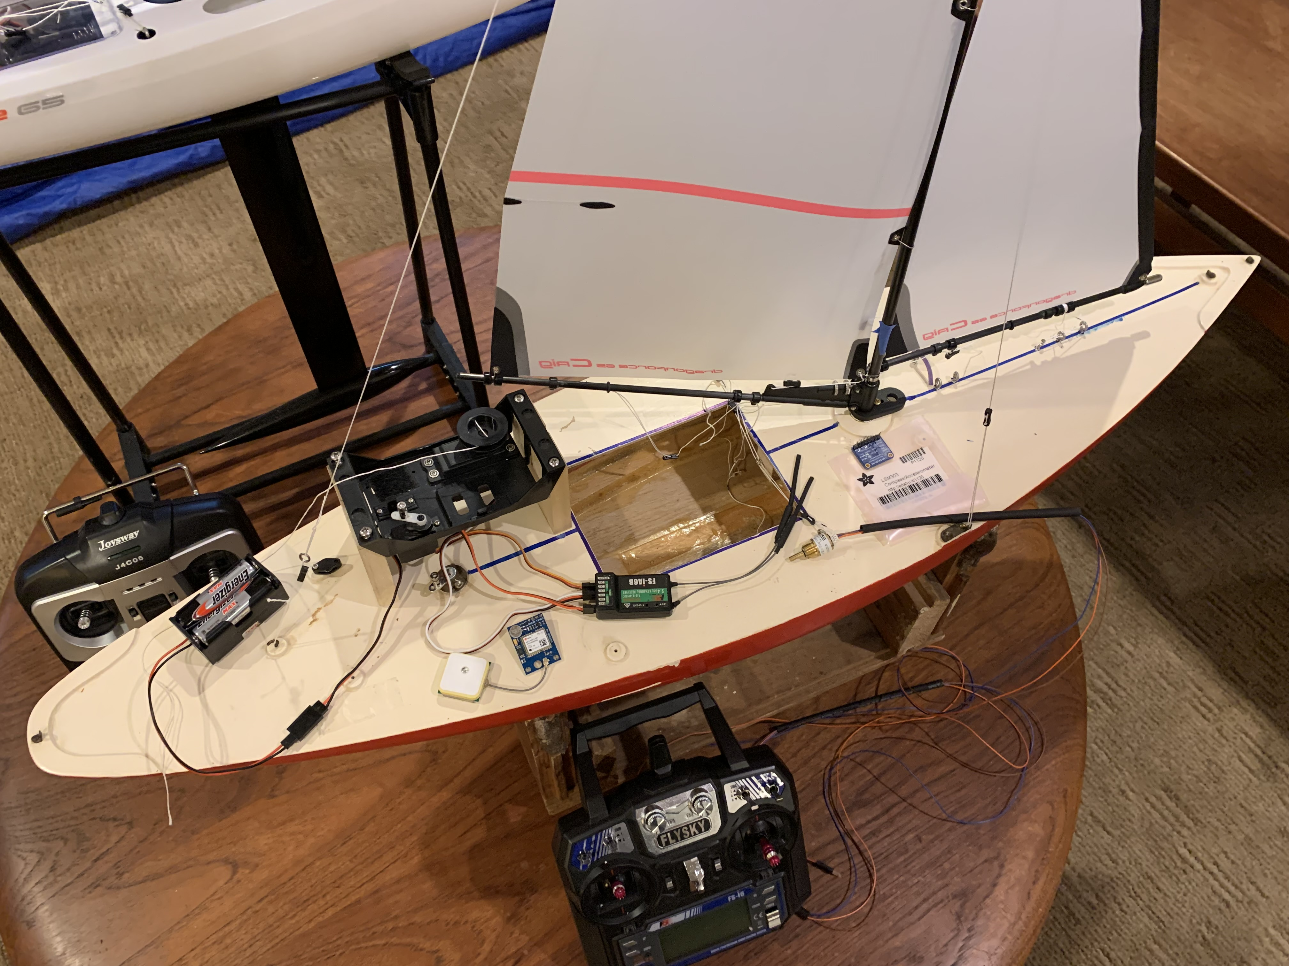
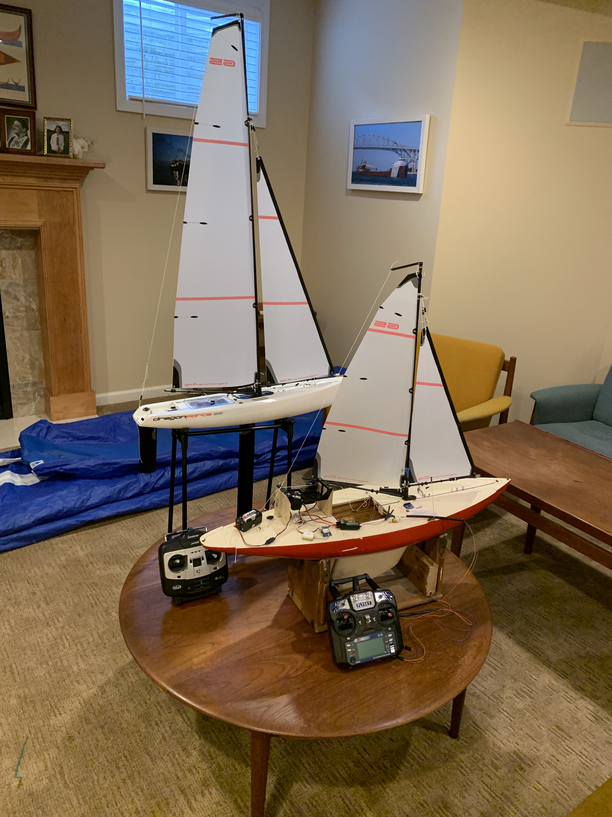
Autonomous Sailboat Project Resources
Sail winch servo
compass
Rudder
servo
5 chl, 2.45 GHz receiver
GPS
Dragonforce65 racing RC
sailboat and test boat
5 chl, 2.45 GHz transmitter
Test boat uses same sail rig (with smaller sails) and controls as Dragonforce65

Slide 7
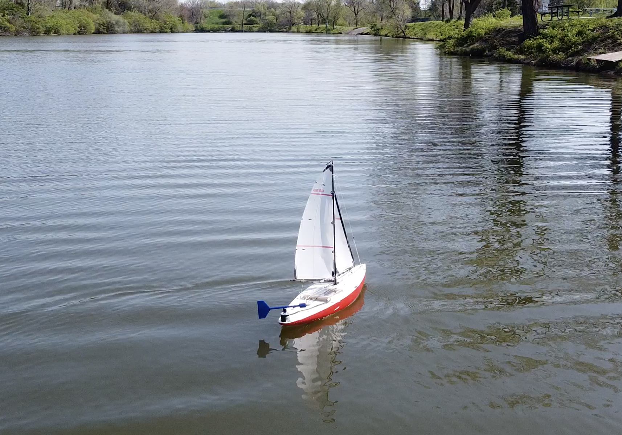
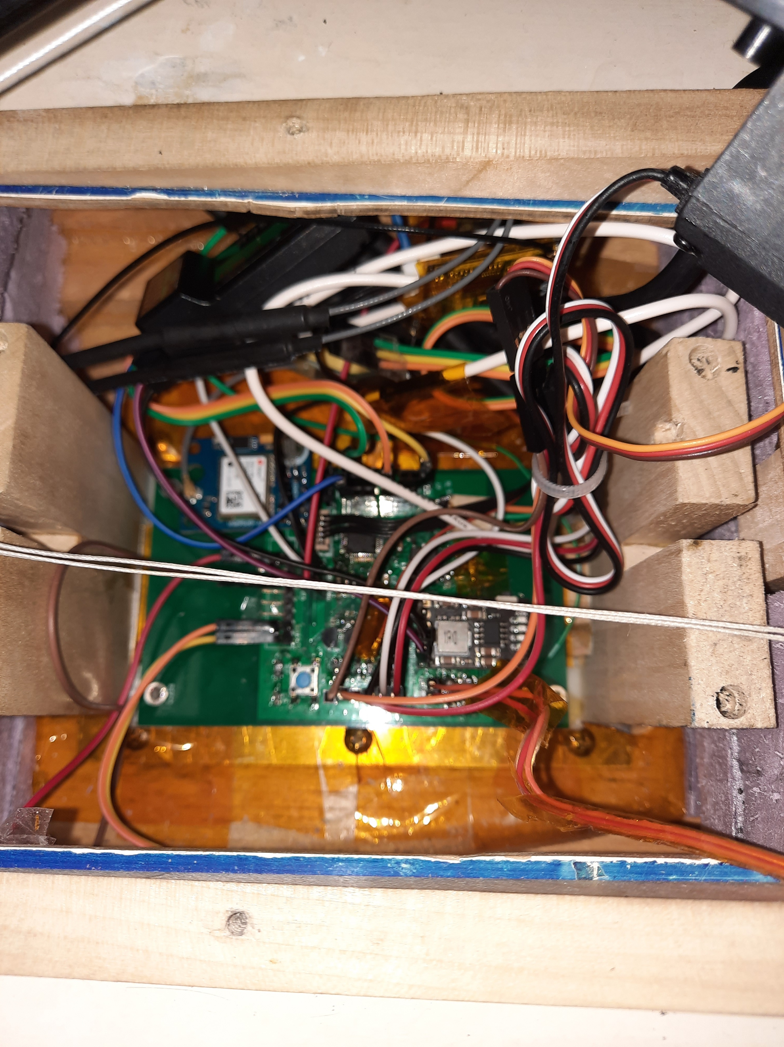
Project 2, Sp2022, boat sailing autonomously
Project 2 boat PCB

Slide 8
Criteria for new project success
Boat has dual mode (RC or autonomous sailing) capability
Boat can sail autonomously up wind or down wind by optimizing sail trim and rudder position using input from
Compass sensor
Wind direction sensor
Heeling sensor
Speed sensor (new)
Boat can sail to base location from an upwind or downwind location
Boat battery can be recharged via a USB or 12V DC port
Boat can display a low-voltage indicator (LED at top of mast) while sailing

Slide 9
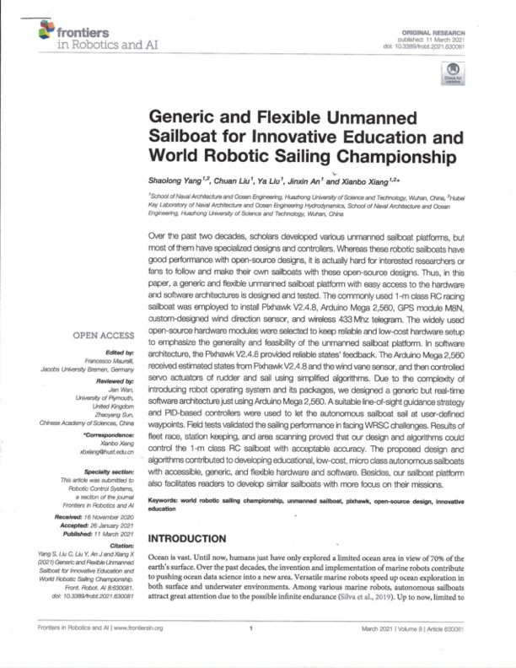
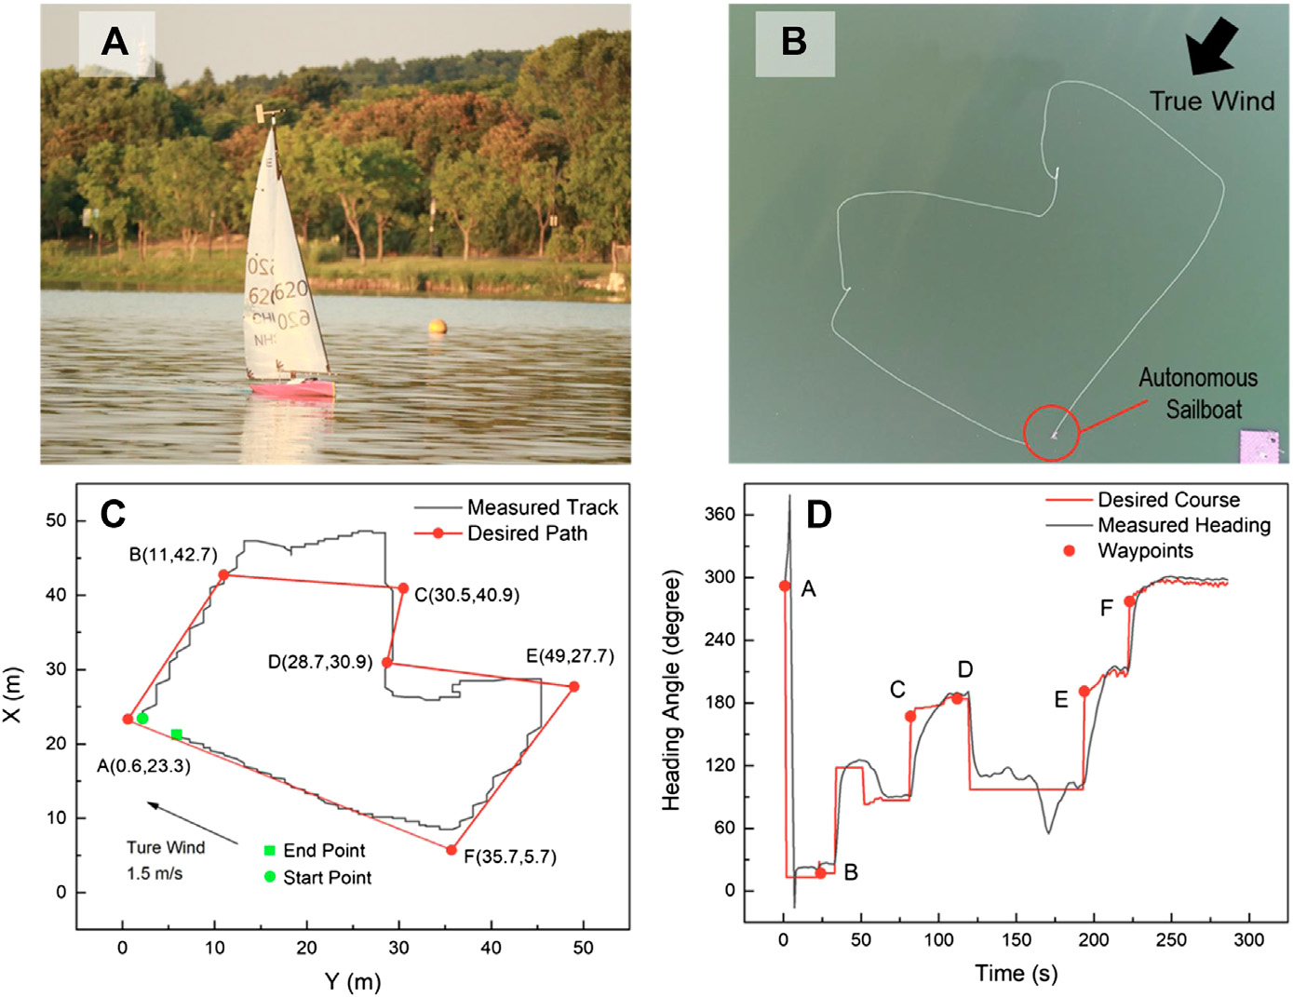
Good resource for background information about this project
Available online: https://www.ncbi.nlm.nih.gov/pmc/articles/PMC7990777/
Contact me for more information if you are interested in doing this project afliflet@Illinois.edu

